Slide 1


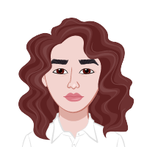

TW project: “Weather App”
Weather Frogs
Our Team:
San
Zinaida
Friday, January 27th 2023
Slide 0
San
Zinaida Jusufovic

Slide 2
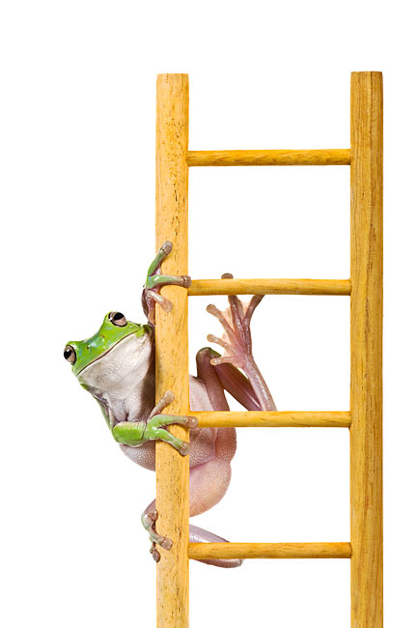
TW project: “Weather App”
Monday: splitting the task, talking about the design, first function fetch the cities, HTML Design
Tuesday: start working with Trello, function background change, fetch weather data
Wednesday: create spinner, background if no pic on Pexels
Thursday: add the favorite Button, make the presentation, refactoring the code
Friday: hold the presentation
Friday, January 27th 2023
Slide 0
San
Zinaida Jusufovic

Slide 3

TW project: “Weather App”
thank you
for your attention
Friday, January 27th 2023
Slide 0
San
Zinaida Jusufovic

